Slide 1
Here, and following are new analyses of the confetti mice. The original ECDF plots follow the new slides (after slide 8). These slides are for the 4 mice (#003, #006, #022, #970) for which data exist for all 6 months of follow-up.
Proportion ECDF (this is essentially the y-axis of the ECDF plots) | UV (log base 2) | No UV (log base 2) | Cubic microns (UV) | Cubic microns (No UV) | % increase (UV over No UV)
0.25 | 14.655 | 14.471 | 25,798.51 | 22,709.37 | 13.6
0.5 | 16.243 | 15.897 | 77,558.65 | 61,020.23 | 27.1
0.75 | 17.943 | 17.672 | 251,988.8 | 208,834.4 | 20.7
1 | 25.846 | 24.536 | 60,314,436 | 24,326,071 | 148

Slide 2
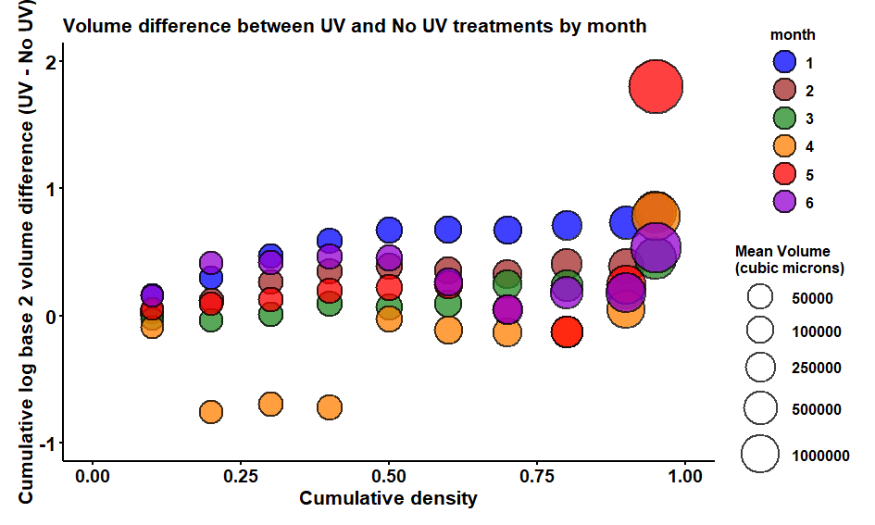

Slide 3
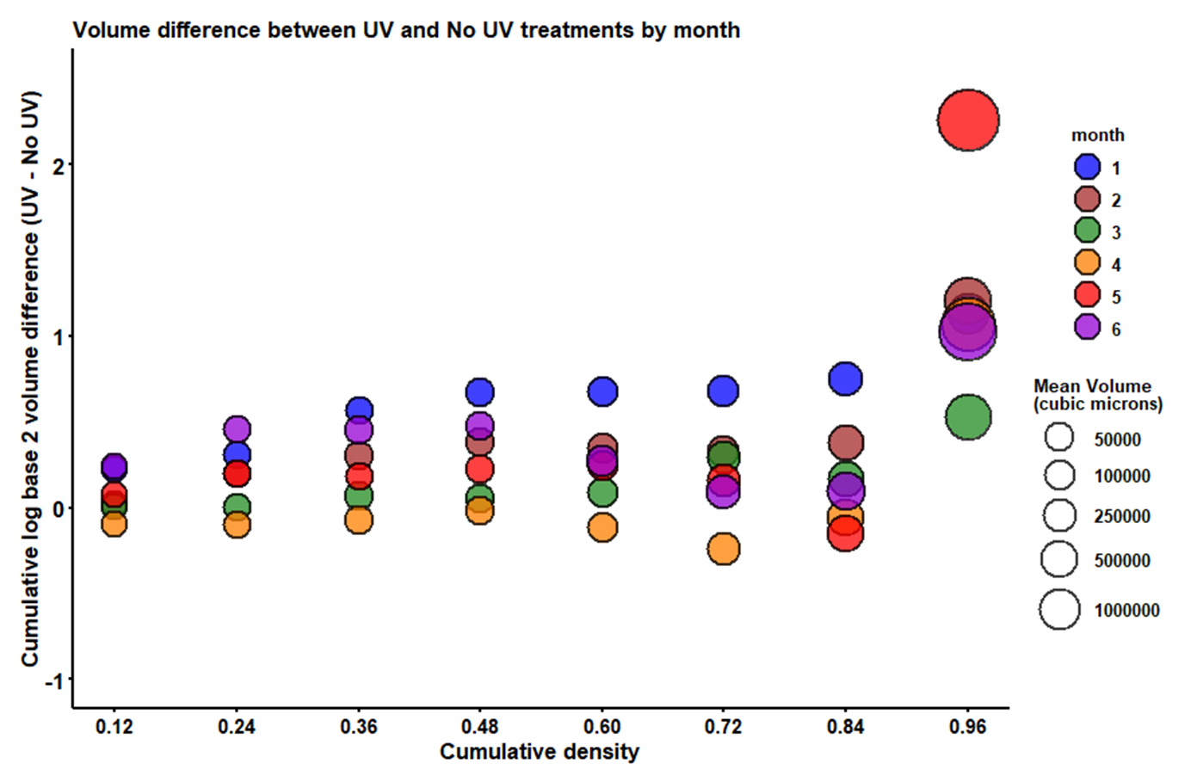

Slide 4
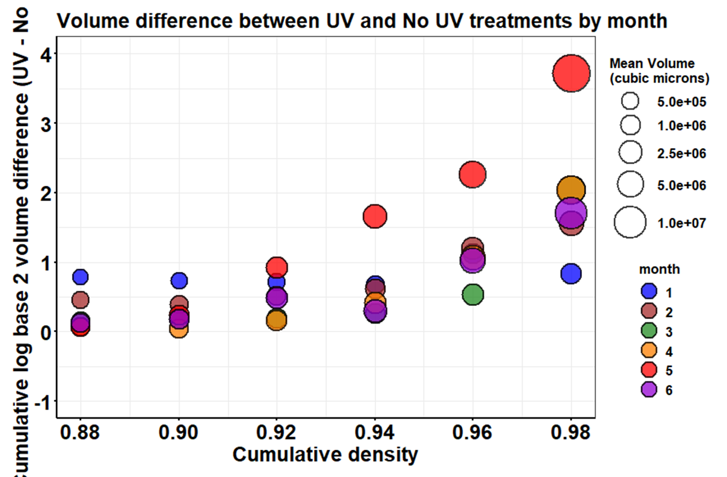

Slide 5
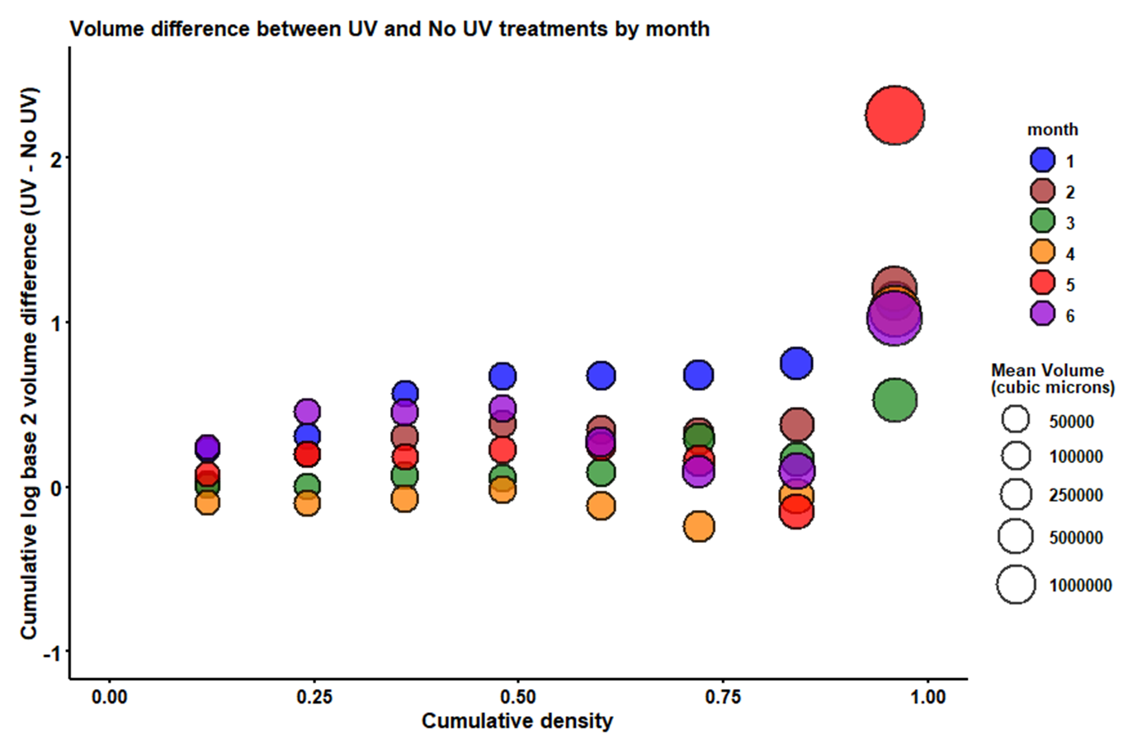

Slide 6
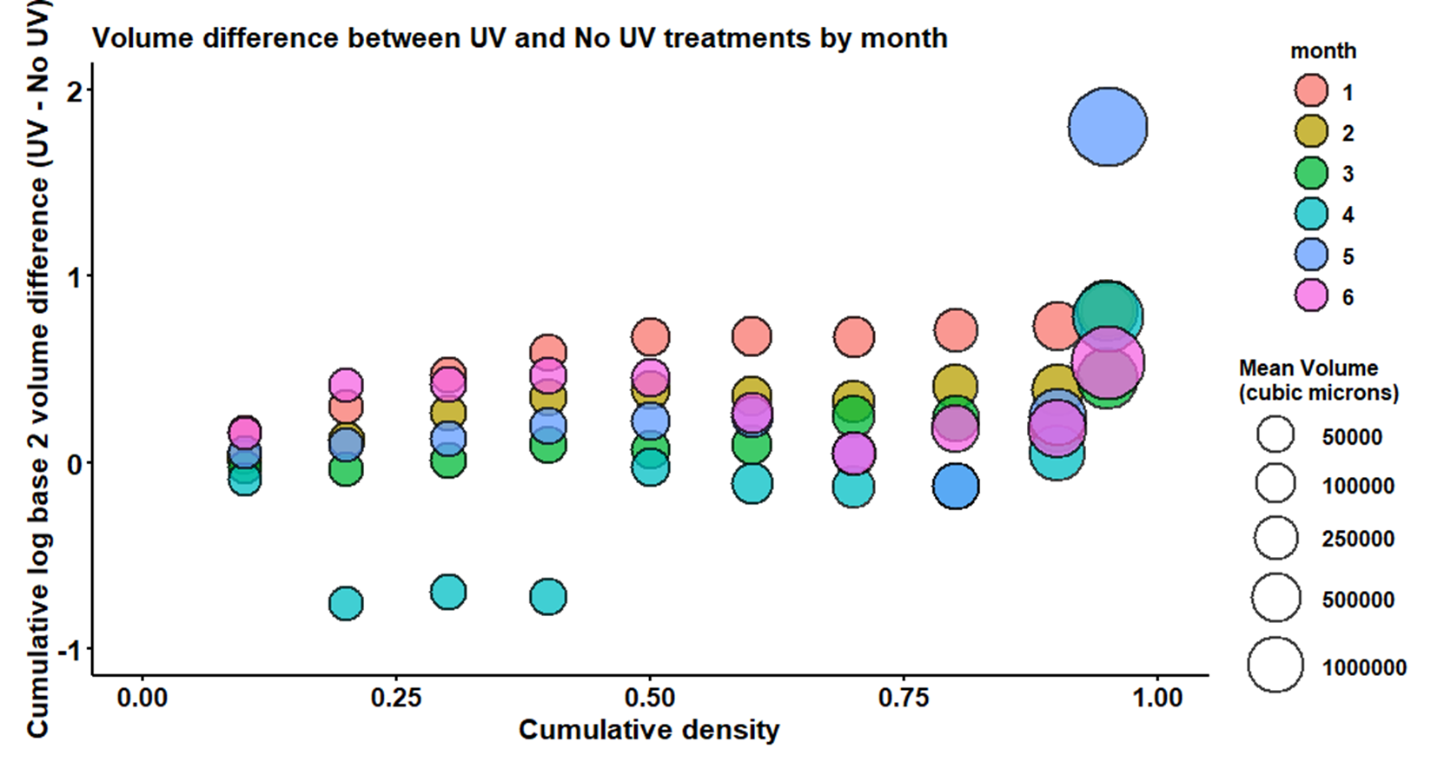

Slide 7
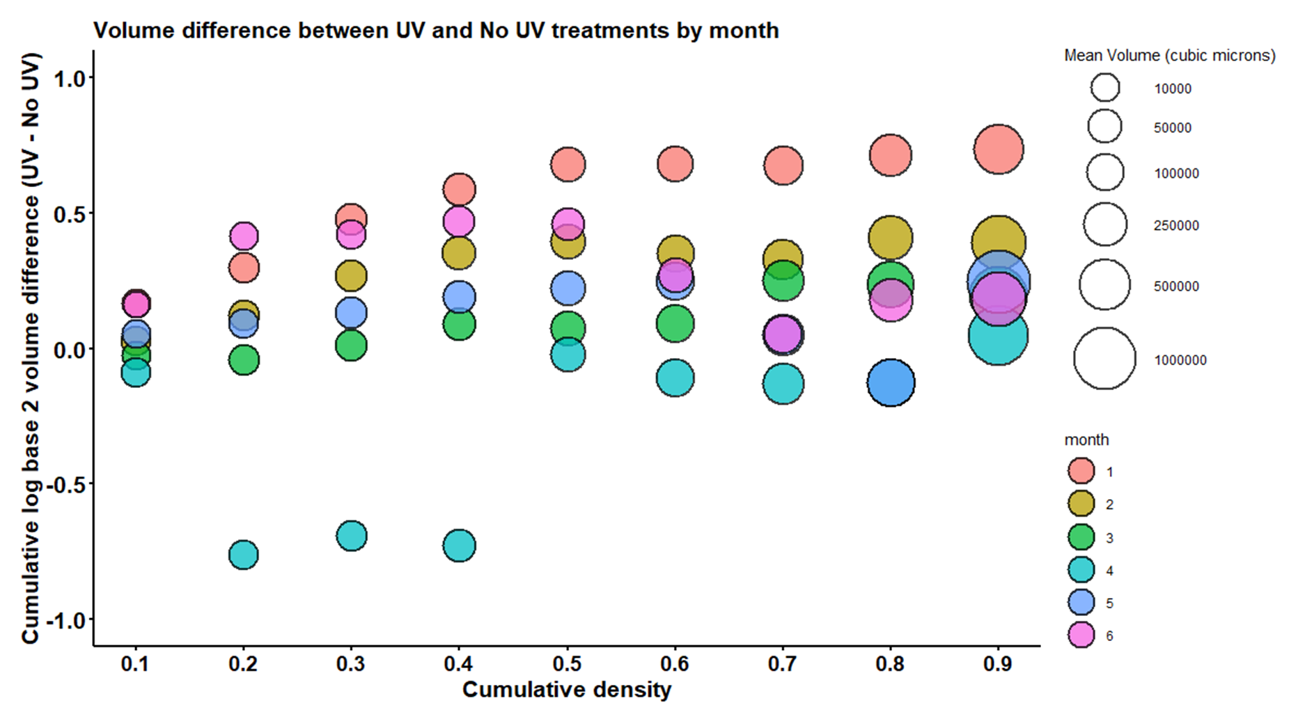

Slide 8
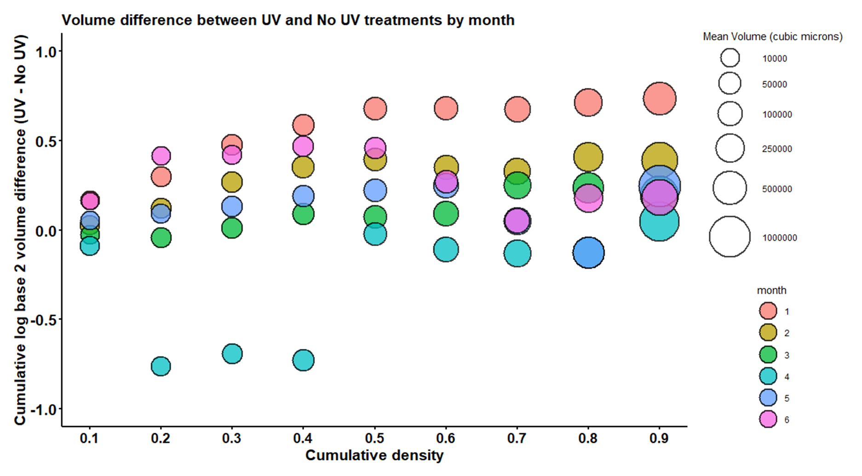

Slide 9
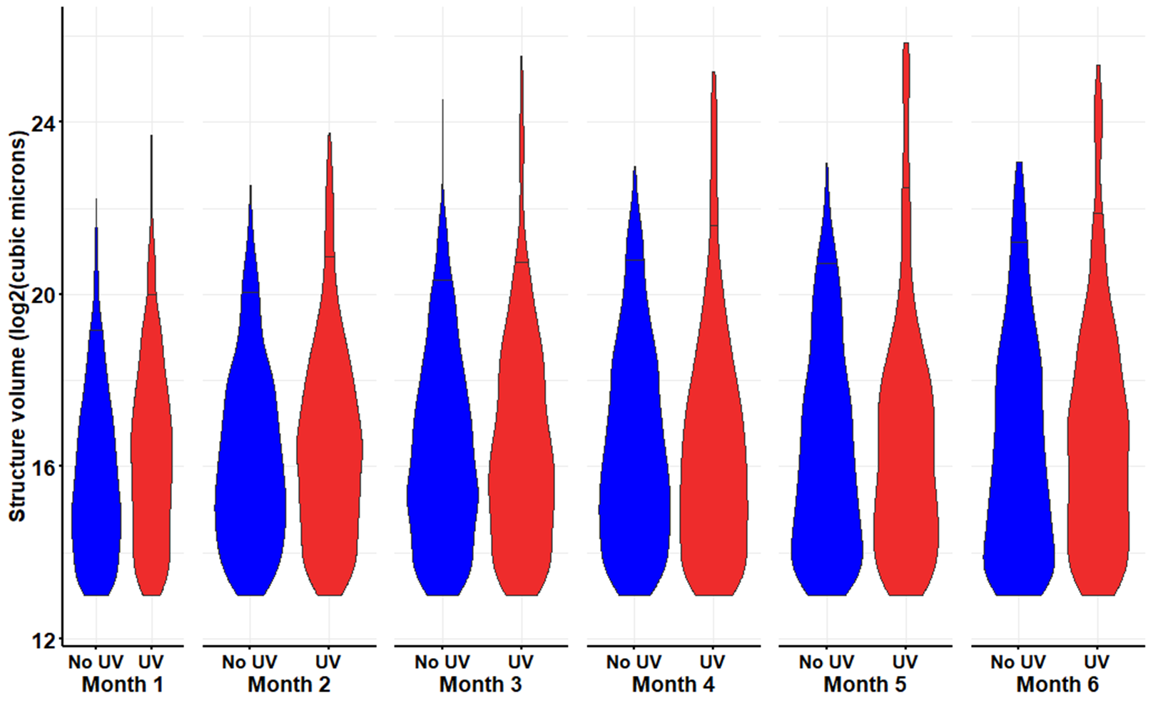

Slide 10
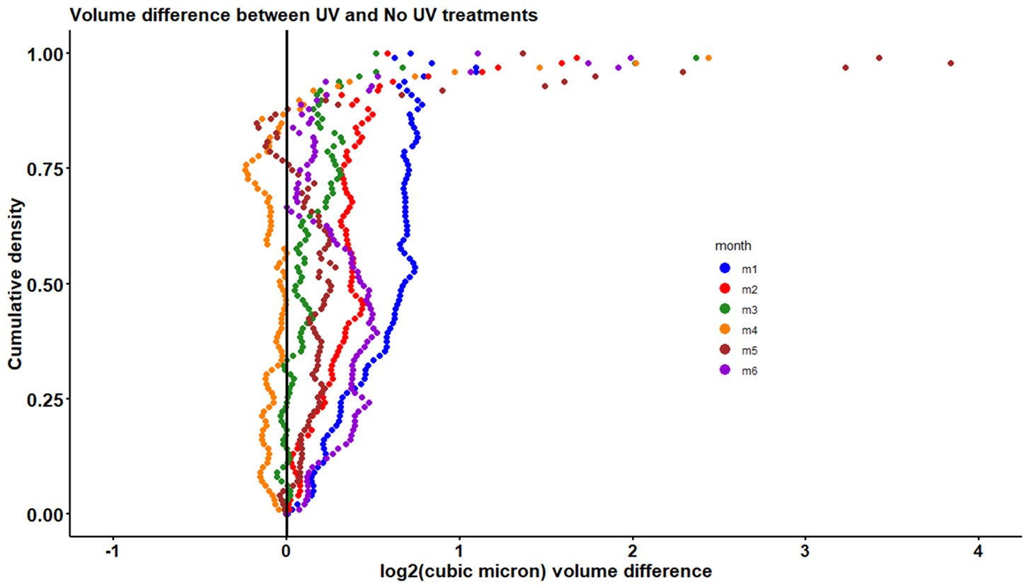

Slide 11
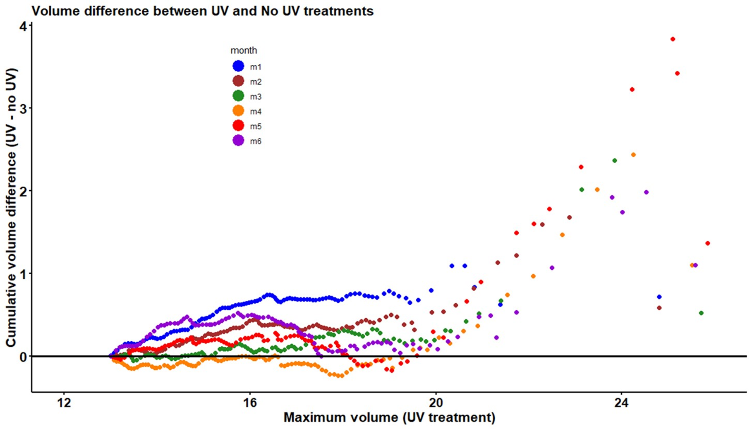

Slide 12
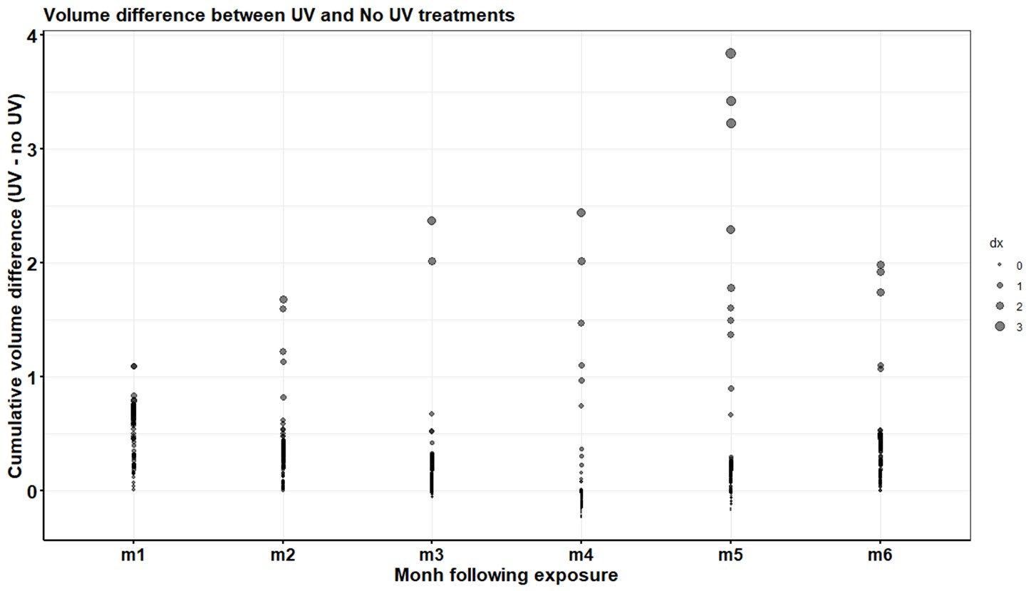

Slide 13
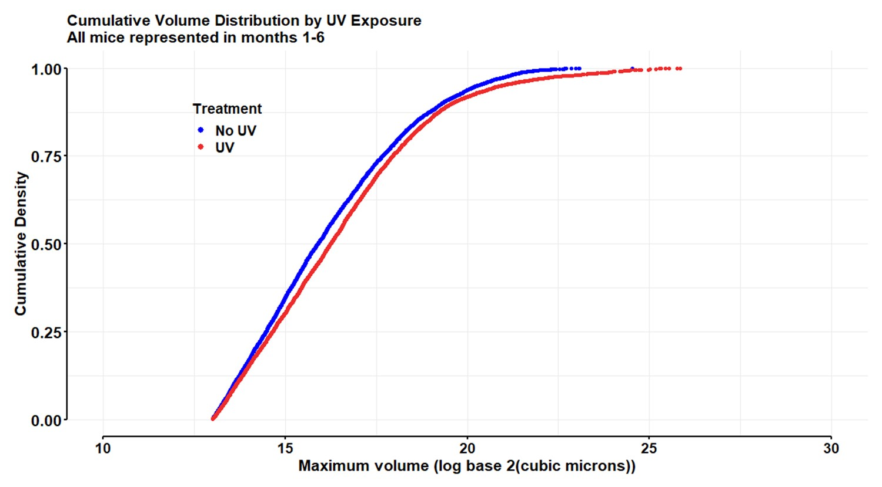
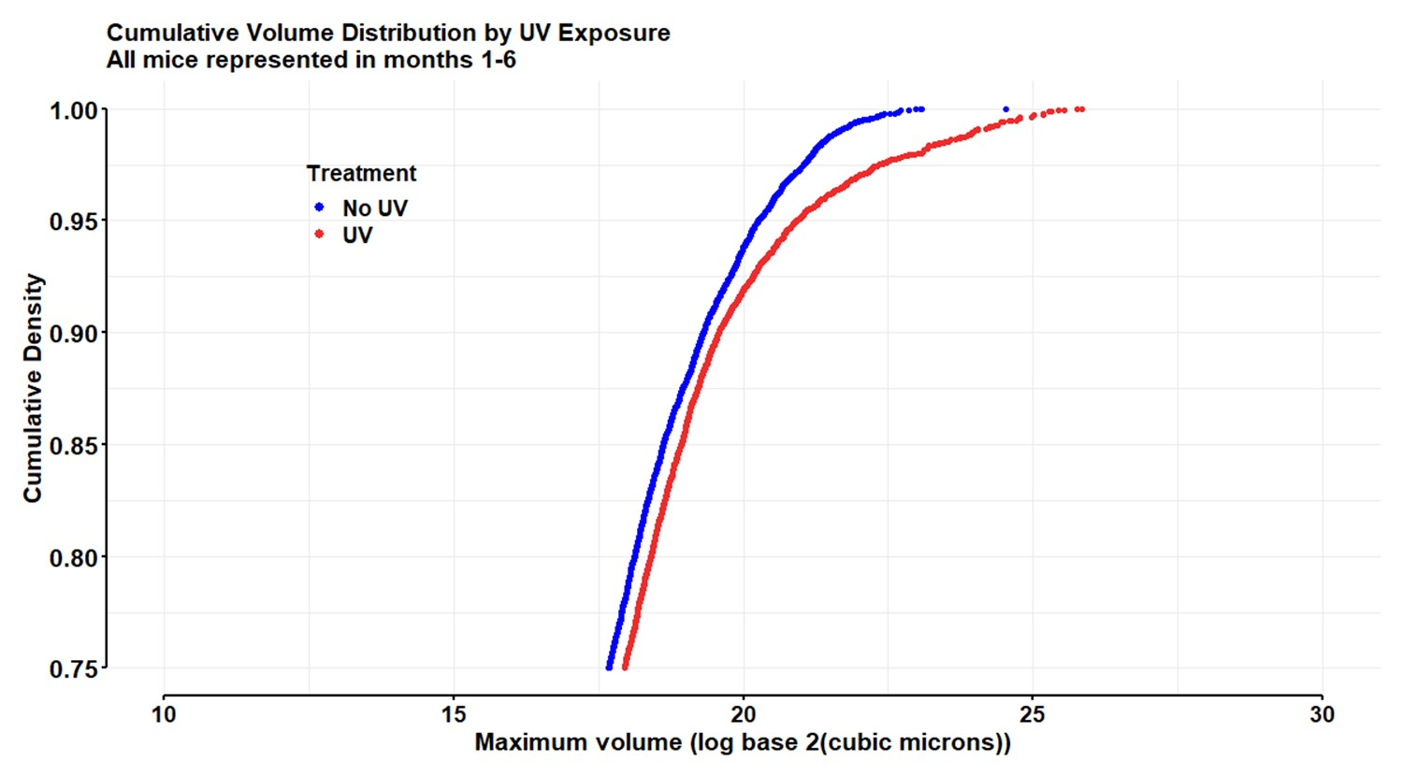
Two-sample Kolmogorov-Smirnov test
D = 0.058599, p-value = 2.076e-11
Anderson-Darling k-sample test.
Sample sizes: 7295, 7437
AD T.AD asympt. P-value sim. P-value
version 1: 27.18 34.38 3.770e-15 0

Slide 14
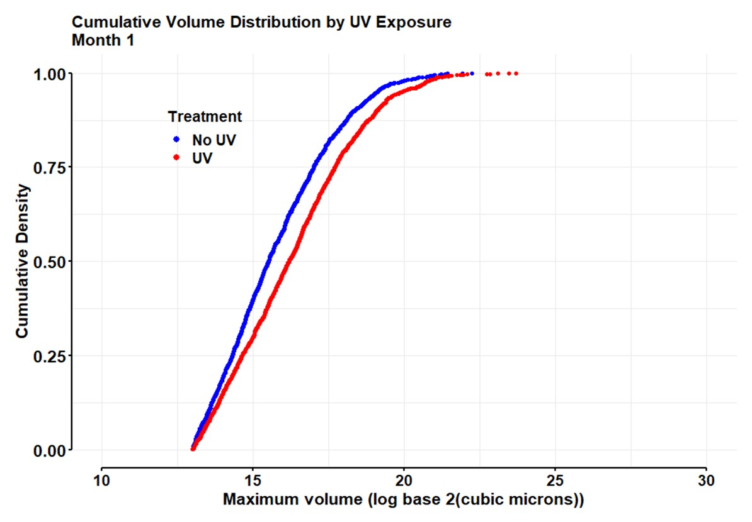
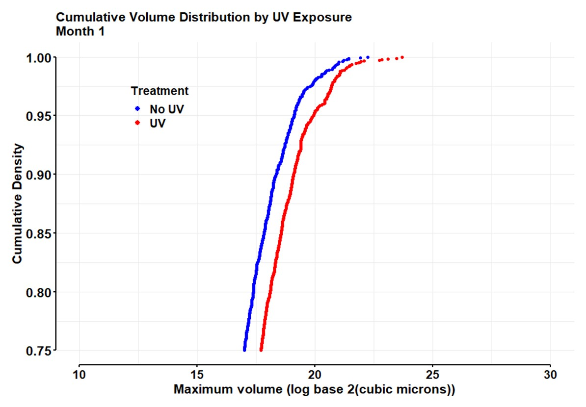
Two-sample Kolmogorov-Smirnov test
D = 0.12838, p-value = 3.878e-13
Anderson-Darling k-sample test
AD T.AD asympt. P-value sim. P-value
version 1: 32.87 41.88 2.770e-18 0

Slide 15
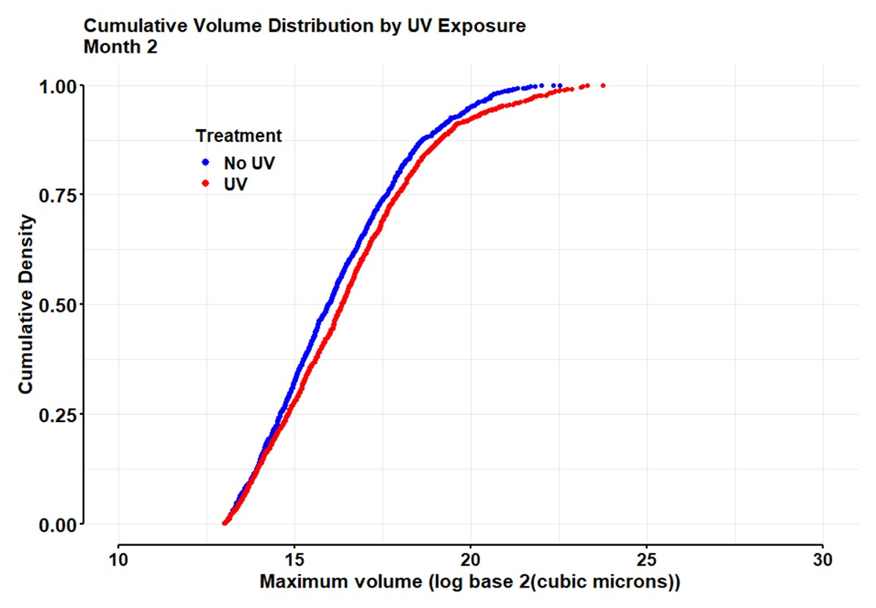
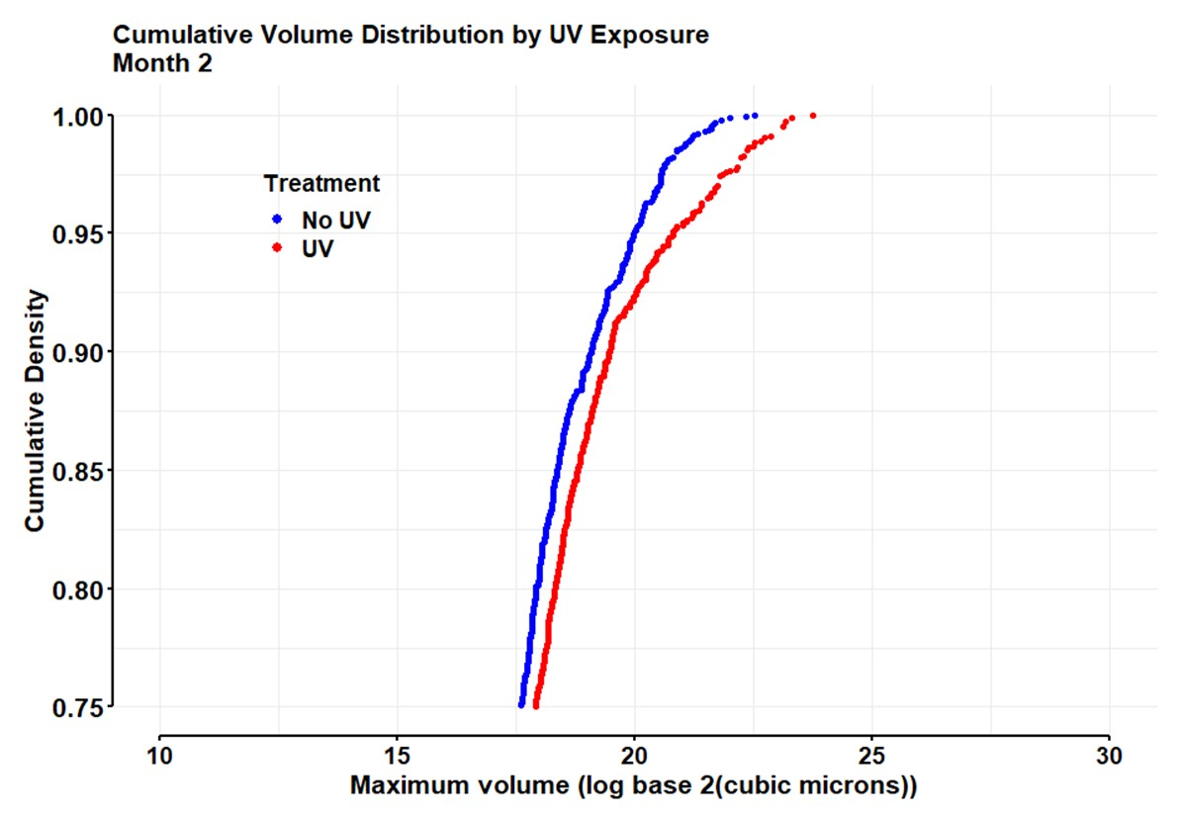
Two-sample Kolmogorov-Smirnov test
D = 0.075337, p-value = 0.0006046
Anderson-Darling k-sample test
AD T.AD asympt. P-value sim. P-value
version 1: 7.918 9.091 0.0001217 0

Slide 16
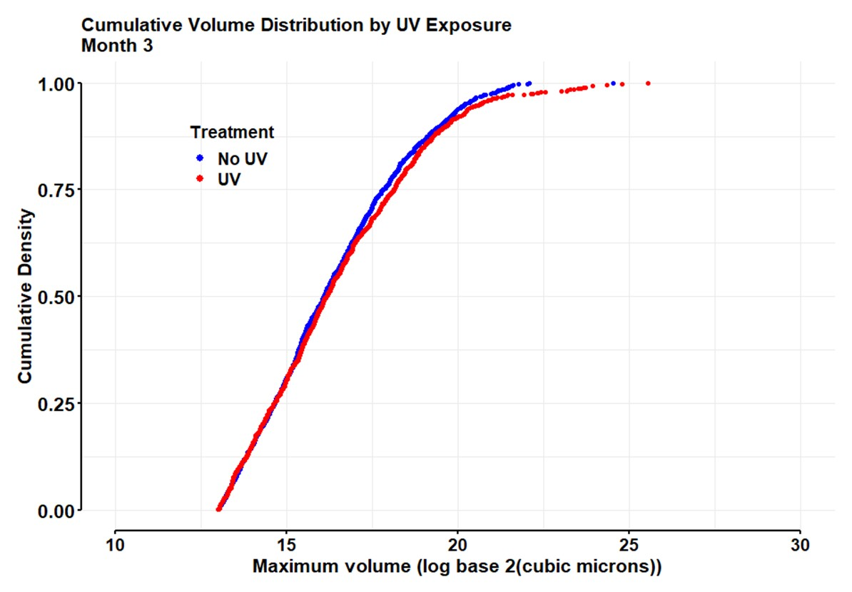
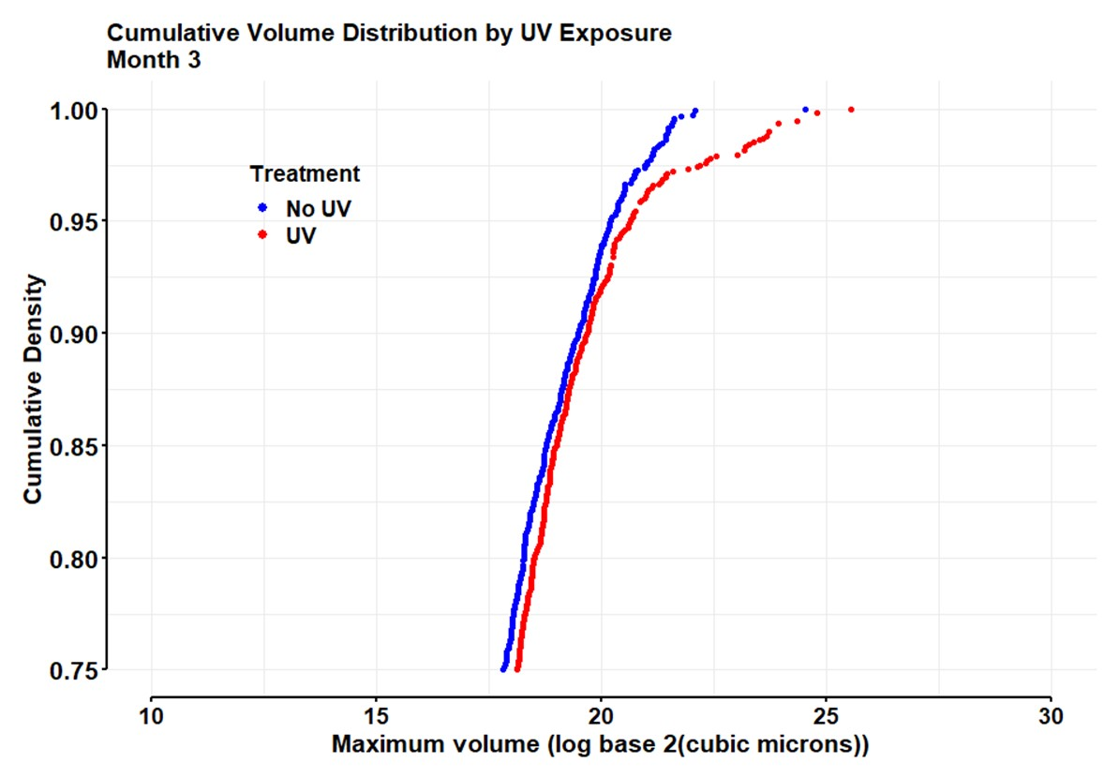
Two-sample Kolmogorov-Smirnov test
D = 0.039298, p-value = 0.3481
Anderson-Darling k-sample test
AD T.AD asympt. P-value sim. P-value
version 1: 1.325 0.4275 0.2241 0.26

Slide 17
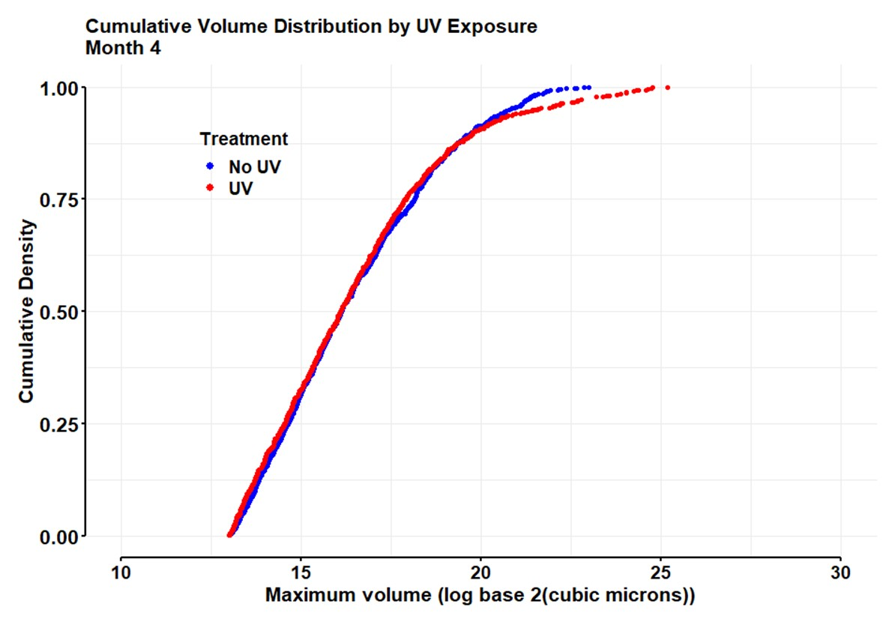
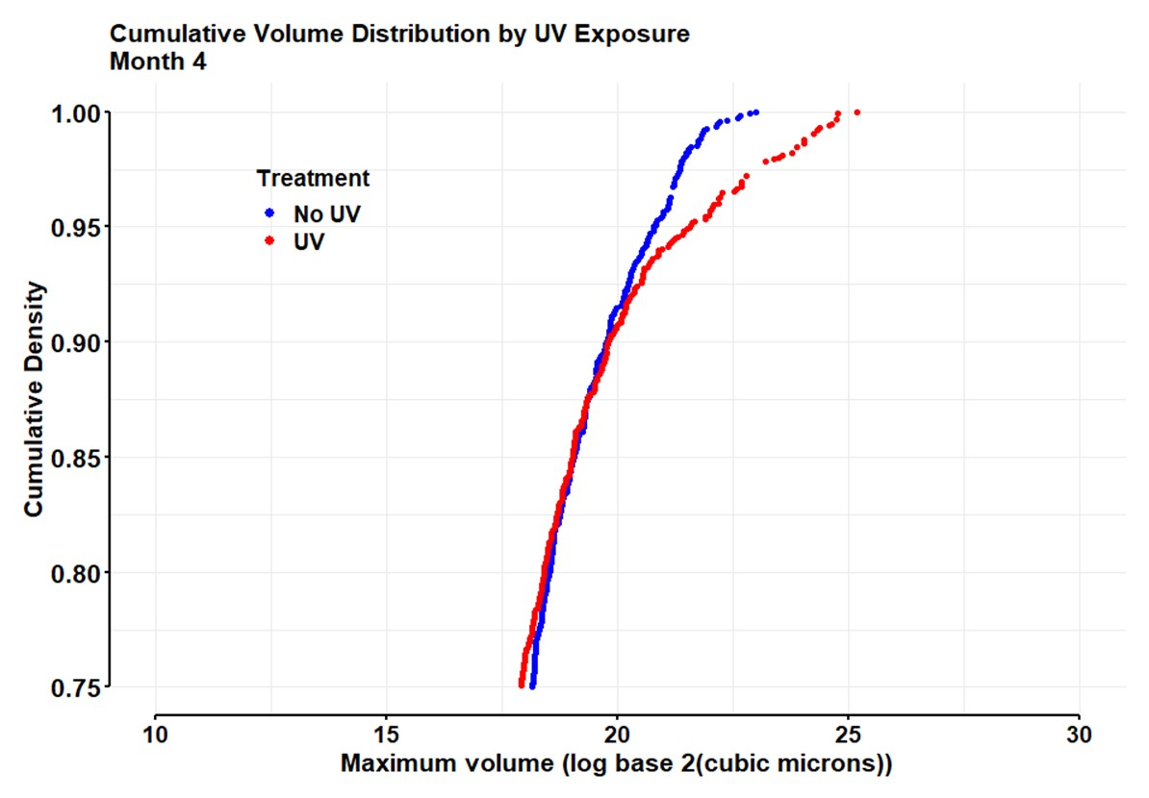
Two-sample Kolmogorov-Smirnov test
D = 0.03928, p-value = 0.3483
Anderson-Darling k-sample test
AD T.AD asympt. P-value sim. P-value
version 1: 1.835 1.098 0.1133 0.121

Slide 18
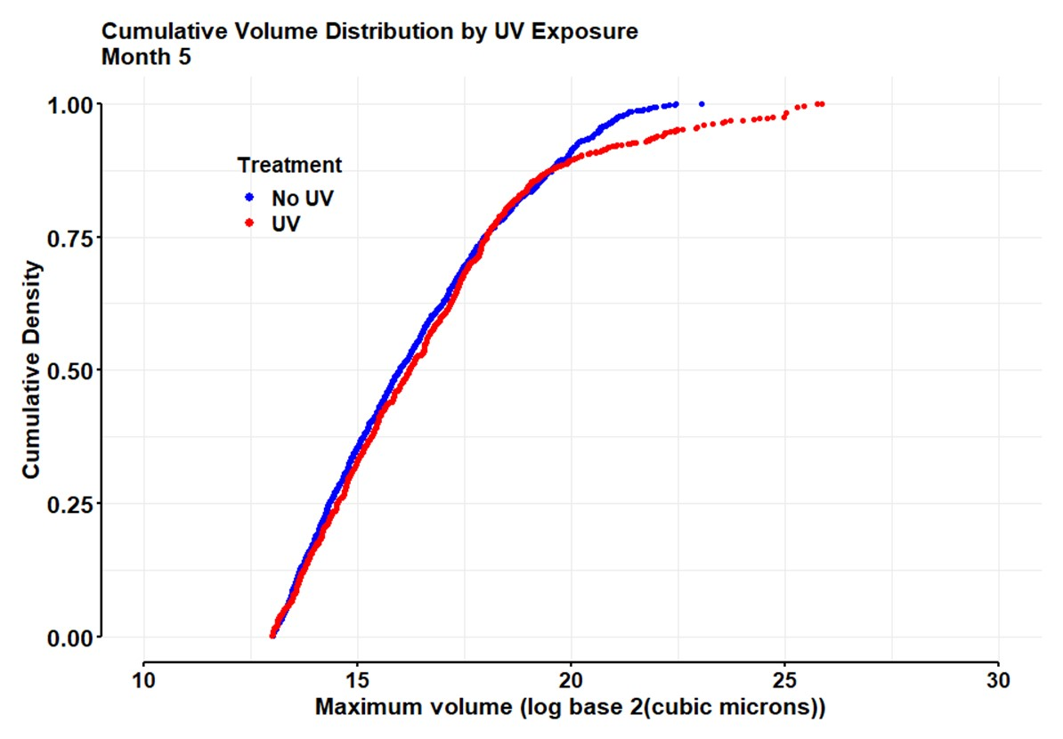
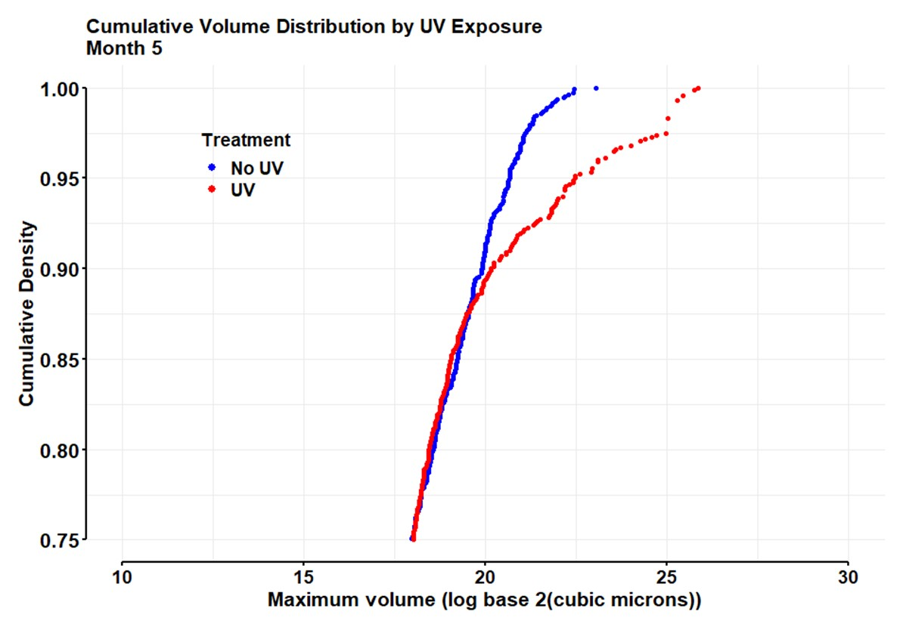
Two-sample Kolmogorov-Smirnov test
D = 0.061438, p-value = 0.05279
Anderson-Darling k-sample test
AD T.AD asympt. P-value sim. P-value
version 1: 3.315 3.043 0.01899 0.016

Slide 19
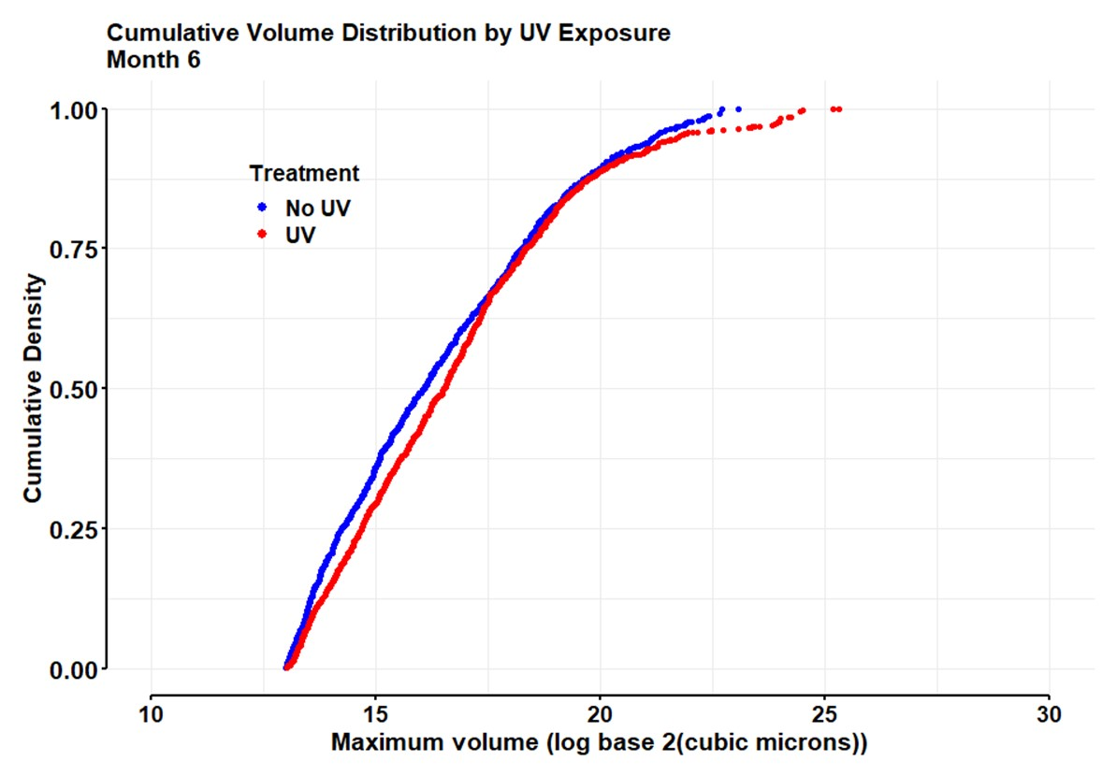
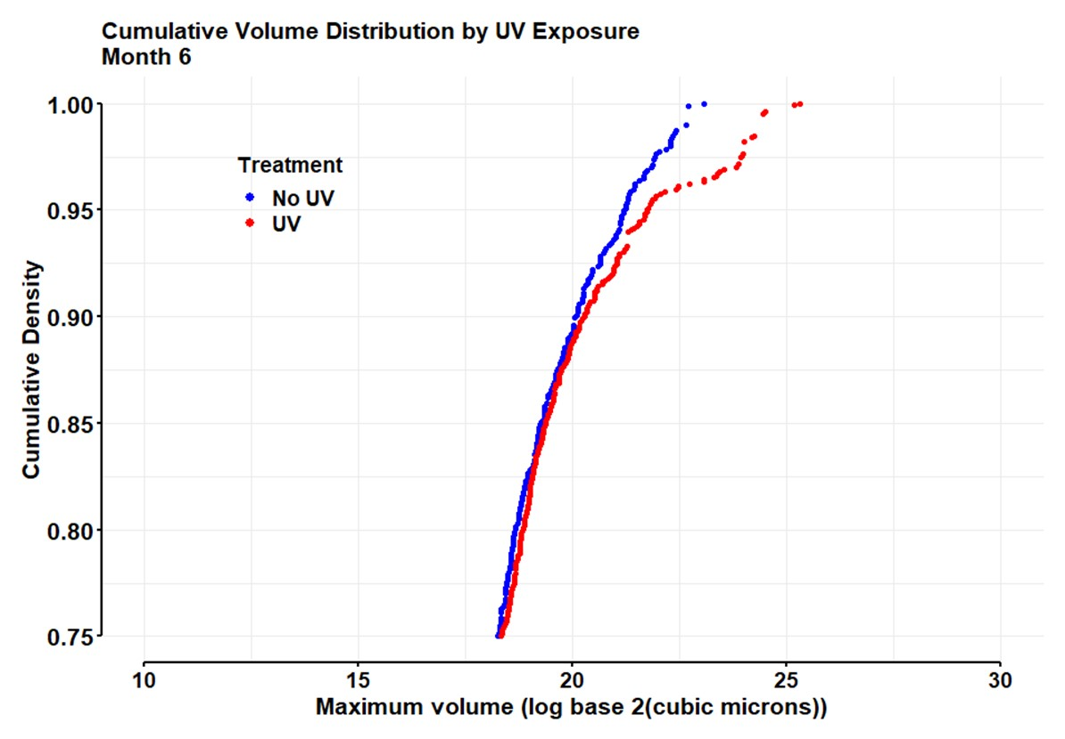
Two-sample Kolmogorov-Smirnov test
D = 0.072427, p-value = 0.01694
Anderson-Darling k-sample test
AD T.AD asympt. P-value sim. P-value
version 1: 5.08 5.364 0.002600 0.003

Slide 20
Slides following show the first ECDF plots created with all data, including month 0

Slide 21
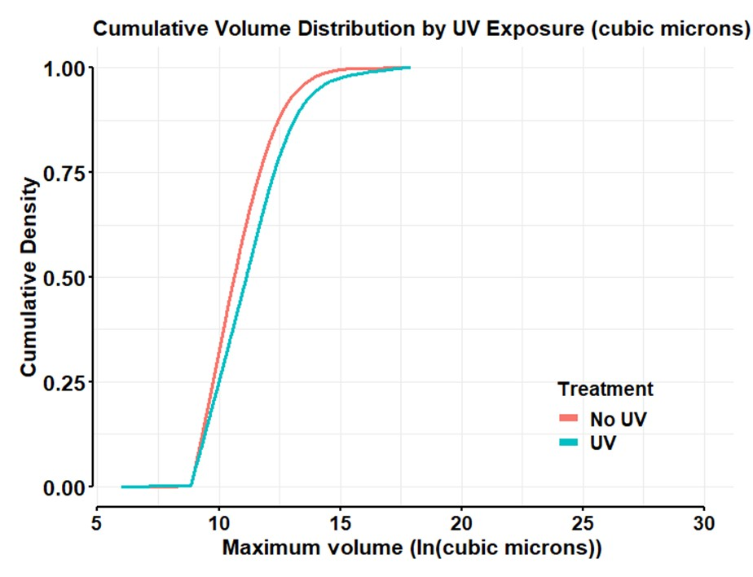
Two-sample Kolmogorov-Smirnov test
D = 0.13023, p-value = 2.2e-16
Anderson-Darling test:
AD T.AD asympt. P-value sim. P-value
version 1: 498.9 653.9 6.978e-274 0

Slide 22
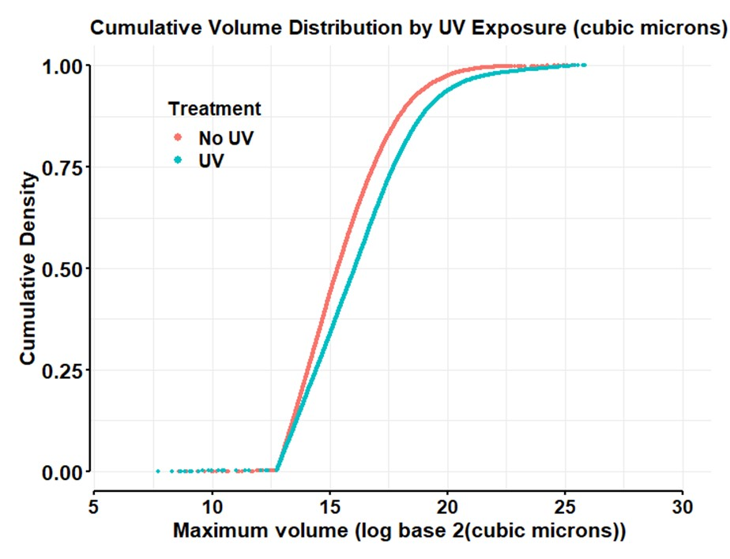
Two-sample Kolmogorov-Smirnov test
D = 0.13009, p-value = 2.2e-16
Anderson-Darling test:
AD T.AD asympt. P-value sim. P-value
version 1: 498.9 653.9 3.191e-274 0

Slide 23
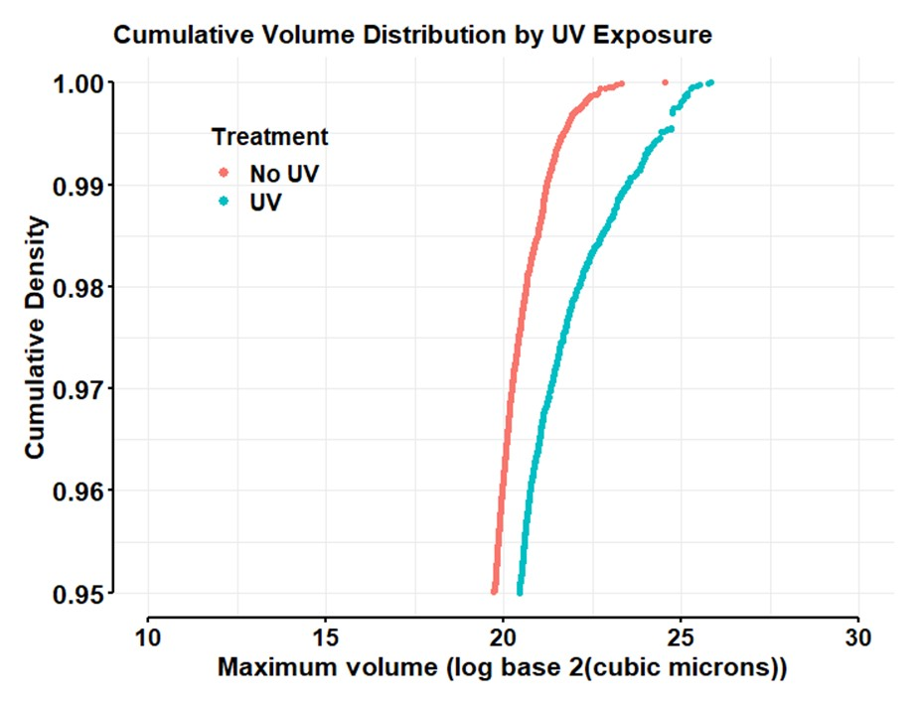

Slide 24
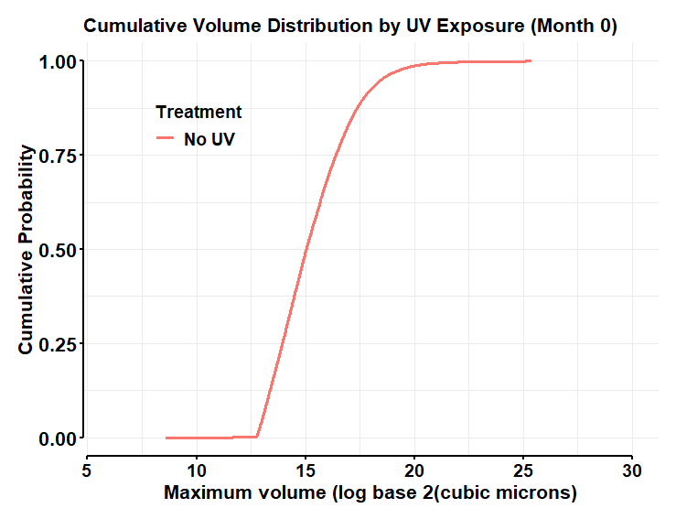
NOTE: No animals are exposed to UV in month 0, so there is only a single ECDF curve.

Slide 25
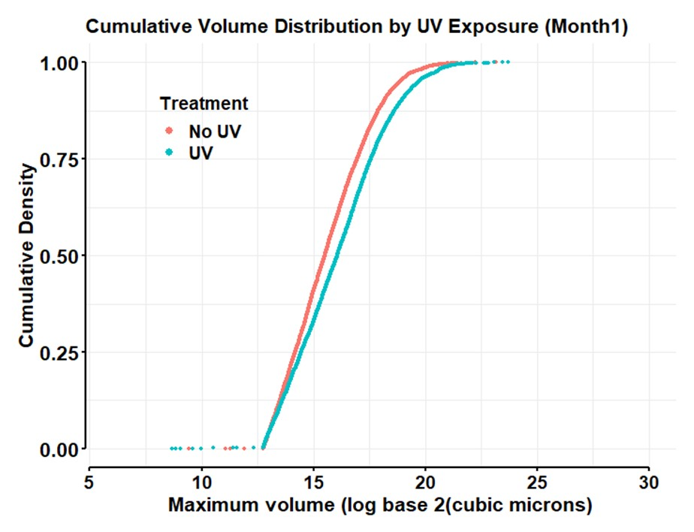
Two-sample Kolmogorov-Smirnov test
D = 0.11131, p-value = 2.2e-16
Anderson-Darling test:
AD T.AD asympt. P-value sim. P-value
version 1: 91.46 118.8 1.834e-50 0

Slide 26
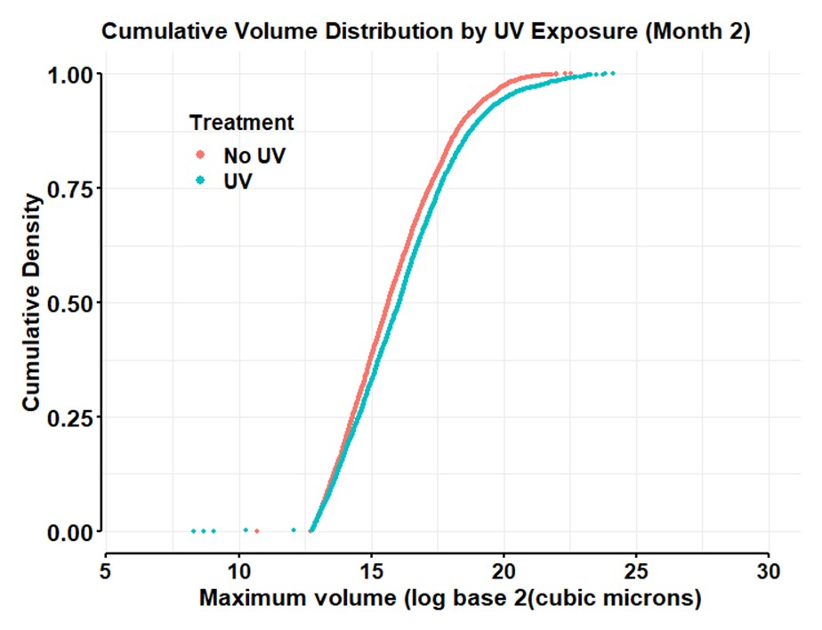
Two-sample Kolmogorov-Smirnov test
D = 0.075631, p-value = 3.076e-11
Anderson-Darling test:
AD T.AD asympt. P-value sim. P-value
version 1: 28.04 35.52 1.269e-15 0

Slide 27
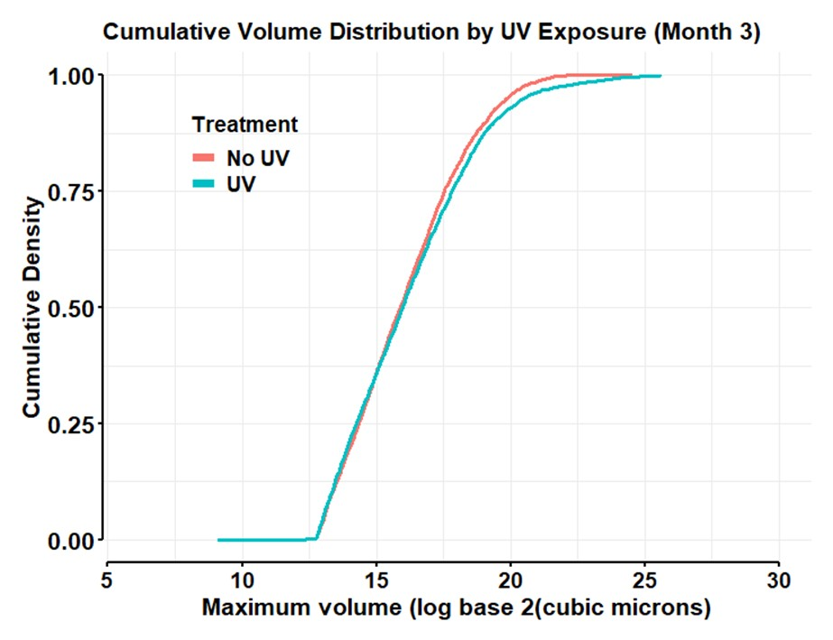
Two-sample Kolmogorov-Smirnov test
D = 0.039965, p-value = 0.009392
Anderson-Darling test:
AD T.AD asympt. P-value sim. P-value
version 1: 6.026 6.602 0.0009144 0

Slide 28
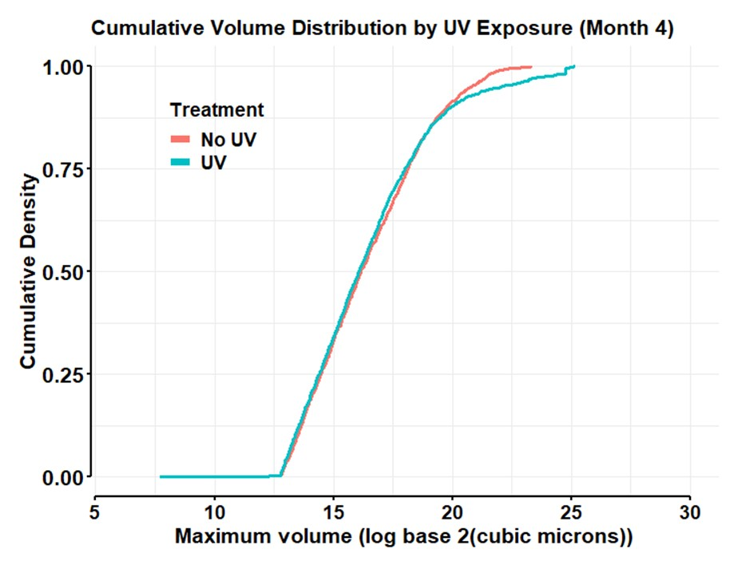
Two-sample Kolmogorov-Smirnov test
D = 0. 042749, p-value = 0. 08025
Anderson-Darling test:
AD T.AD asympt. P-value sim. P-value
version 1: 2.956 2.571 0.02888 0

Slide 29
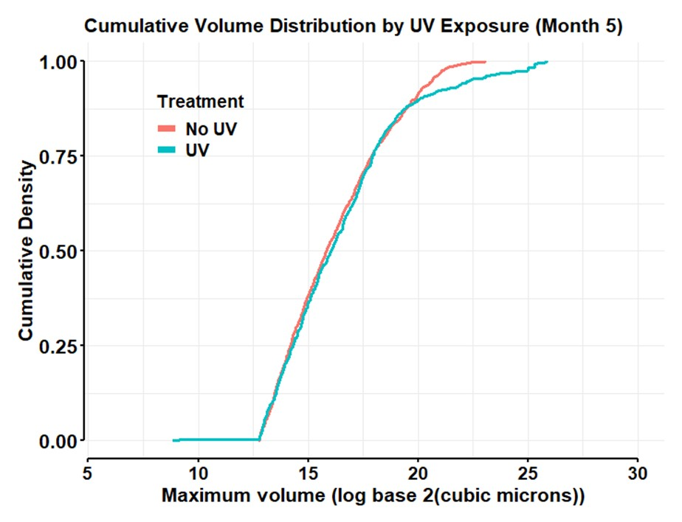
Two-sample Kolmogorov-Smirnov test
D = 0.058499, p-value = 0.06381
Anderson-Darling test:
AD T.AD asympt. P-value sim. P-value
version 1: 2.839 2.418 0.03314 0

Slide 30
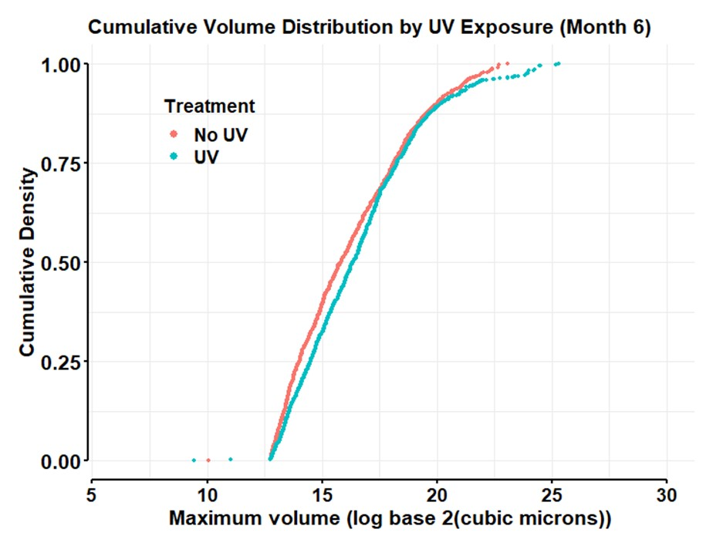
Two-sample Kolmogorov-Smirnov test
D = 0.078226, p-value = 0.005818
Anderson-Darling test:
AD T.AD asympt. P-value sim. P-value
version 1: 6.098 6.702 0.0008387 0

Slide 31
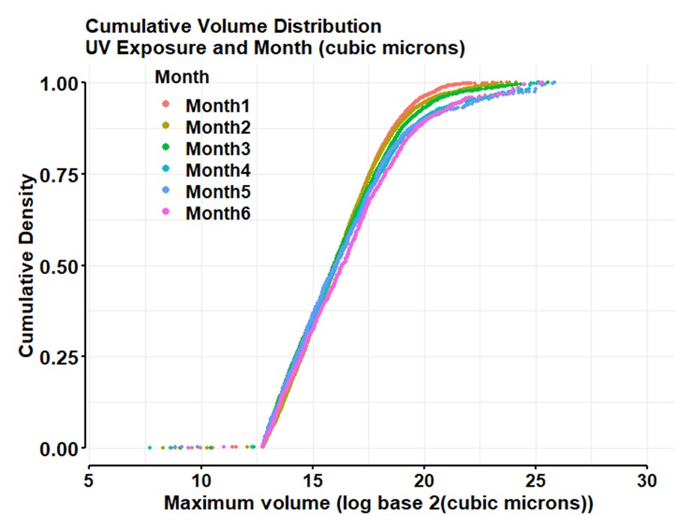

Slide 32
